Slide 1

Department of Computer Science and Engineering -AI
THEME NO: 03
Adaptive Video Streaming & Buffer Management Engine
TEAM NO:14
Sl.no | Name | Roll.no | USN
1. | Divya Kumari | 222 | 01FE24BCI094
2. | Akshay Bhat | 210 | 01FE24BCI024
3. | Renuka Kagadal | 243 | 01FE24BCI119
4. | B Bhagyashree | 231 | 01FE24BCI104
Guide: Amit Kachavimath , Department of CSE-AI

Slide 2
PROBLEM
Current Situation & Observation
Many clients watch videos from the same server at the same time.
Network speed can change during playback.
When the network slows down, chunks take longer to download.
A low buffer can make the video stop or rebuffer.
More clients means more load on the server, so chunks may reach clients late.
Frequent network changes can make video quality unstable.
Why Existing Approaches Are Insufficient
ABR algorithms choose quality for one client using its own speed.
When speed changes suddenly, they take time to pick the right quality.
Small, frequent changes cause constant quality switching.
Many clients asking together can overload the server and slow everyone.
Sending the same chunk again and again from storage is slow. Server caching can help.

Slide 3
Who Is Involved
Stakeholder | Role | Need | Difficulty Faced | Expected Benefit
Video Viewers (Primary) | Watch the video (many at the same time) | Smooth playback and good quality | Video may stop when the buffer becomes empty | Less buffering and better playback
Video Server (Secondary) | Stores, caches and sends chunks to many clients | Serve many clients at the same time | Many requests together; network speed keeps changing | Less load and faster delivery using cache
Video Clients (Secondary) | Download and play video; each client selects its own quality | Correct quality and enough buffer | Hard to choose quality when speed changes or server is busy | Better quality with fewer stalls
Developer / Project Team (Secondary) | Builds and tests the system | Simple and measurable system | Hard to test many clients and changing network speed | Easier testing and performance analysis

Slide 4
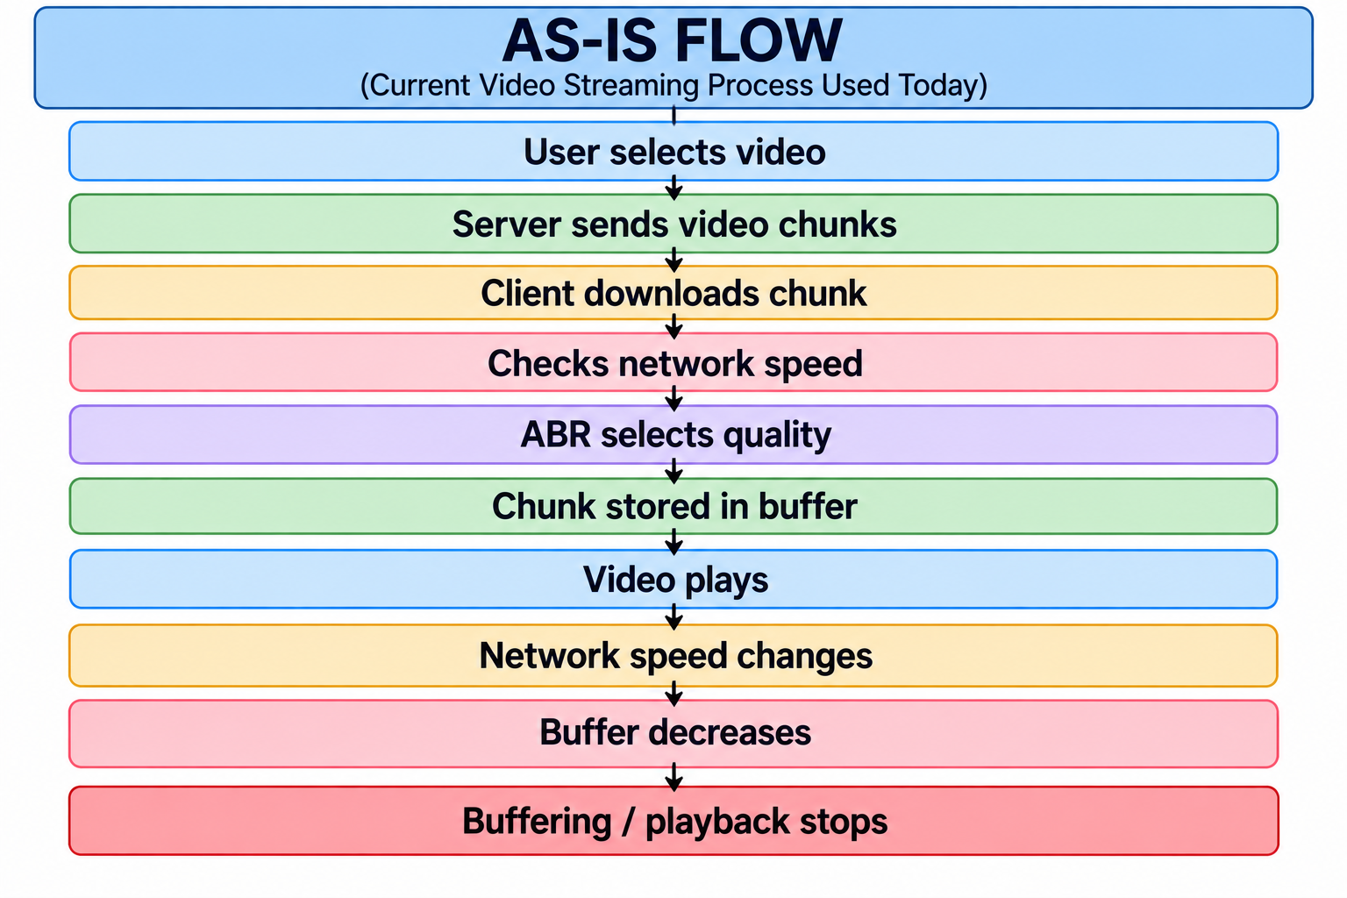
AS-IS FLOW : Current Video Streaming Process

Slide 5
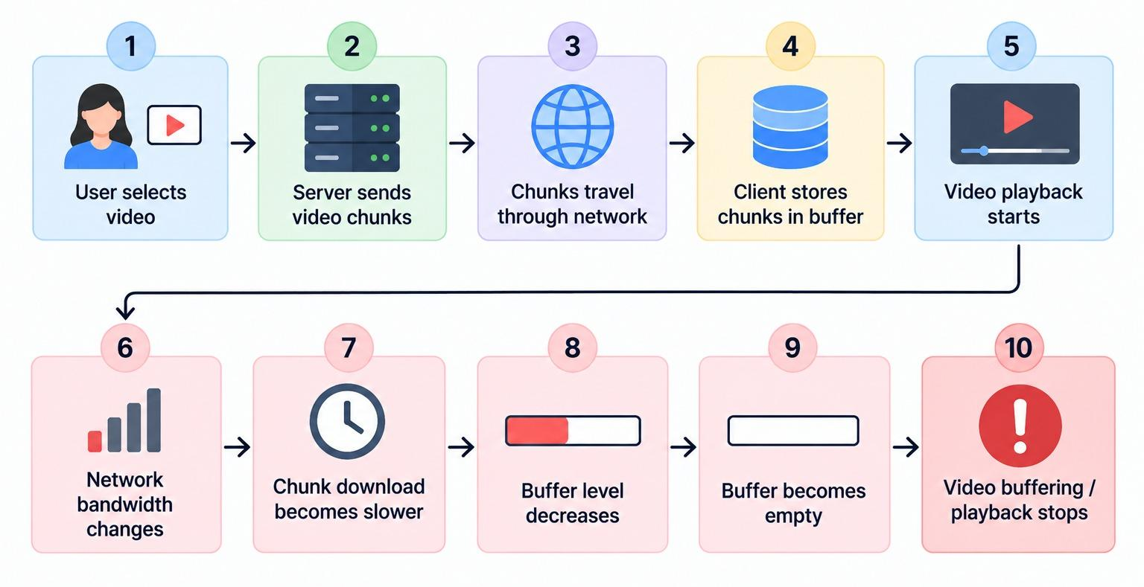
Current Video Streaming Process

Slide 6
Problem Statement
Video streaming depends on the network speed and on how many clients use the same server. When the network slows down, video chunks take longer to download and the playback buffer goes down. This can lead to video buffering and playback interruption. When the network keeps changing, video quality may also change often. When many clients ask the server at the same time, the server becomes busy and delivery gets slower. Therefore, the main challenge is to maintain continuous playback and stable video quality for multiple clients by adapting video bitrate, managing playback buffers, and handling many requests together (with caching on the server) under changing network conditions.

Slide 7
Project Objectives
To understand how changing network speed and many clients affect video streaming.
To study the balance between video quality, smooth playback and network use.
To develop a system where each client picks its own video quality automatically, without manual help.
To handle many client requests together and reduce server load using server-side caching.
To assess system behaviour for many clients using metrics like rebuffering, bitrate, switches and cache hits.

Slide 8
Technical Feasibility
Foundation Courses & Concepts
Foundation Course | Concepts
Computer Networks | Sockets, TCP and HTTP, packets, bandwidth, delay (latency), throughput, client-server communication
Operating Systems | Processes and threads (serve many clients), synchronization (locks, so threads share the cache safely), memory, cache
Data Structures & Algorithms | Queues (buffer), hash tables (cache lookup), heaps (request order), moving average (speed estimate)
Supporting Foundation Courses & Concepts
Foundation Course | Concepts
Software Engineering & SDLC | Client-server design, requirements, use cases and testing
Database Management Systems | Stores logs, test results and cache data

Slide 9
What's Included
In Scope
Splitting video into chunks at many bitrates
Chunk delivery from server to many clients (HTTP)
Handling many client requests together
Server-side caching of chunks
Speed estimation from chunk downloads
Client-side ABR choice for the next chunk
Playback buffer management and prefetching
Testing with changing speeds and many clients
Out of Scope
Real-time video encoding.
Video transcoding.
DRM.
Live video streaming.
OVERALL ASSESSMENT
Focus only on video-on-demand streaming for many clients, with ABR, buffer management and server caching.

Slide 10
CAN WE DO THIS ?
FEASIBILITY
Within the defined 3-credit scope.
Quality selection, buffer management, handling many clients, server caching, network simulation and testing can be built and tested as a controlled streaming system.
CONSTRAINTS
Simulation may not match all real conditions
Limited videos, quality levels, test clients and computer power
Fixed project time.

Slide 11
What Could Go Wrong ?
Possible Risks
Wrong speed estimation
→ Wrong video quality may be selected.
Sudden network drop
→ Video may start buffering.
Buffer becomes empty
→ Playback stops.
Frequent speed changes
→ Video quality may change too often.
Too many clients at once
→ Server is slow; chunks arrive late.
Cache miss or missing chunk
→ Chunk is slow to get; playback may stop.
How We Handle Them
Test different network speeds.
Monitor buffer level.
Measure quality changes.
Test sudden speed drops.
Test cache hits and missing chunks.
Test with many clients.
The main risk is choosing the wrong video quality when network speed changes or many clients use the server.

Slide 12
How Will We Know It Works?
KPI | What We Will Check
Rebuffering Ratio | How much time each client’s video is stopped because of buffering
Average Bitrate | The average video quality selected by each client
Buffer Underflow Count | How many times the buffer becomes empty and playback stops
Bitrate-Switch Frequency | How many times the video quality changes during playback
Server Load | How well the server works when many clients watch at the same time
Cache Hit Ratio | How many chunk requests are served from the server cache

Slide 13
Evidence That the Problem Is Real
Real-Life Context
Platforms like YouTube and Netflix automatically adjust video quality based on network conditions.
When the Internet becomes slow or unstable, higher-quality video may take longer to load or may buffer.
Video quality may therefore change during playback as network conditions change.
Popular videos are watched by many users at the same time, so servers use caching to share the load.
Research has tested video streaming with 63,508 real users.
The study found that real Internet conditions make bitrate selection difficult.
Sources: USENIX NSDI 2020; USENIX ATC 2012.

Slide 14


Adaptive Video Streaming & Buffer Management
analyticsCurrent Situation & Observation
Video streaming performance depends heavily on dynamic network conditions.
Network bandwidth can fluctuate unpredictably during active video playback.
When bandwidth decreases, individual video segments take significantly longer to download.
If the playback buffer level drops too low, video playback halts and enters a buffering state.
Frequent and erratic changes in video quality severely degrade the overall user viewing experience.
warning_amberWhy Existing Approaches Are Insufficient
ABR algorithms are standard for quality adjustment based on speed, but lag during sudden transitions.
Rapid network drops leave current quality settings too high or too low for immediate playback needs.
Example Scenario:
If network speed suddenly drops from 5 Mbps to 1 Mbps, fetching a high-quality segment takes too long, immediately causing video buffering.
Continuous small fluctuations cause constant quality switching, ruining playback stability.
CORE CHALLENGE
Maintaining an optimal balance between high video quality and continuous, smooth playback under changing network conditions.
2
11-09-2026
Department of Computer Science and Engineering

